Slide 1
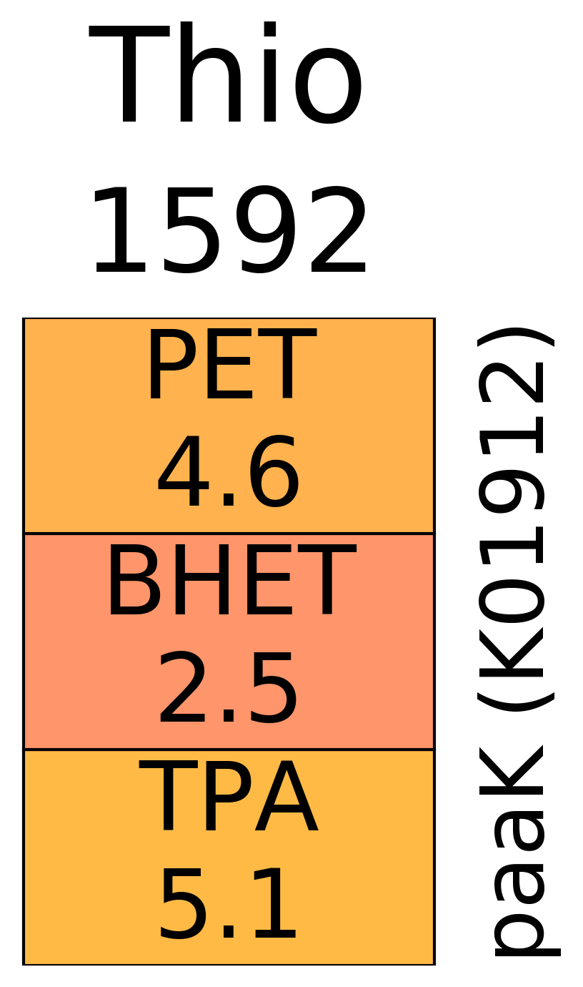
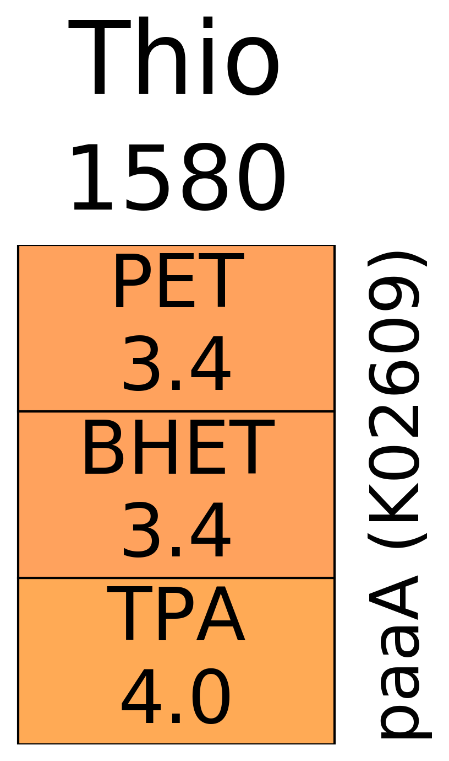
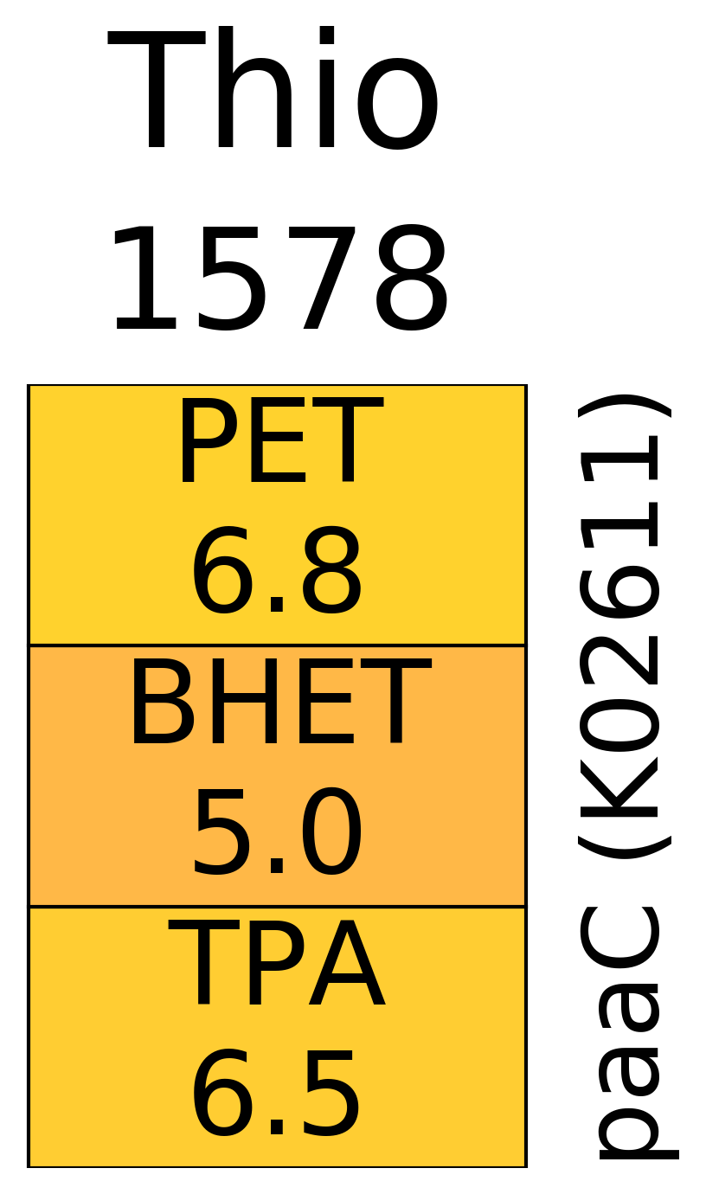
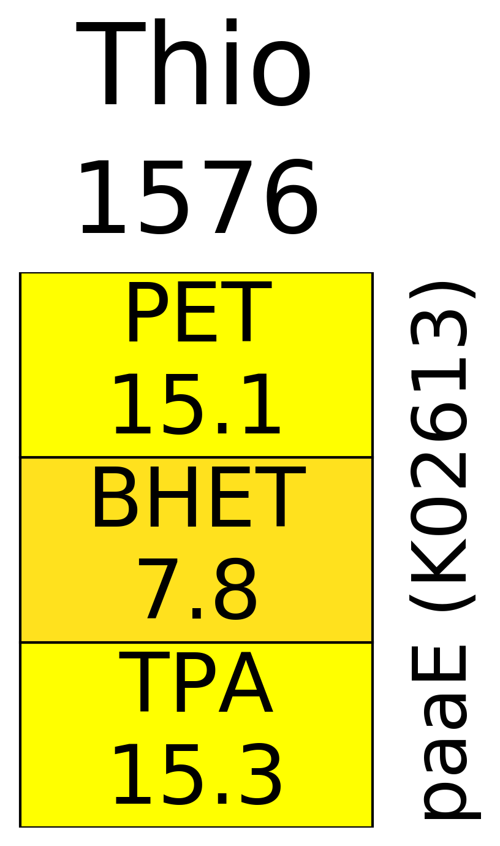
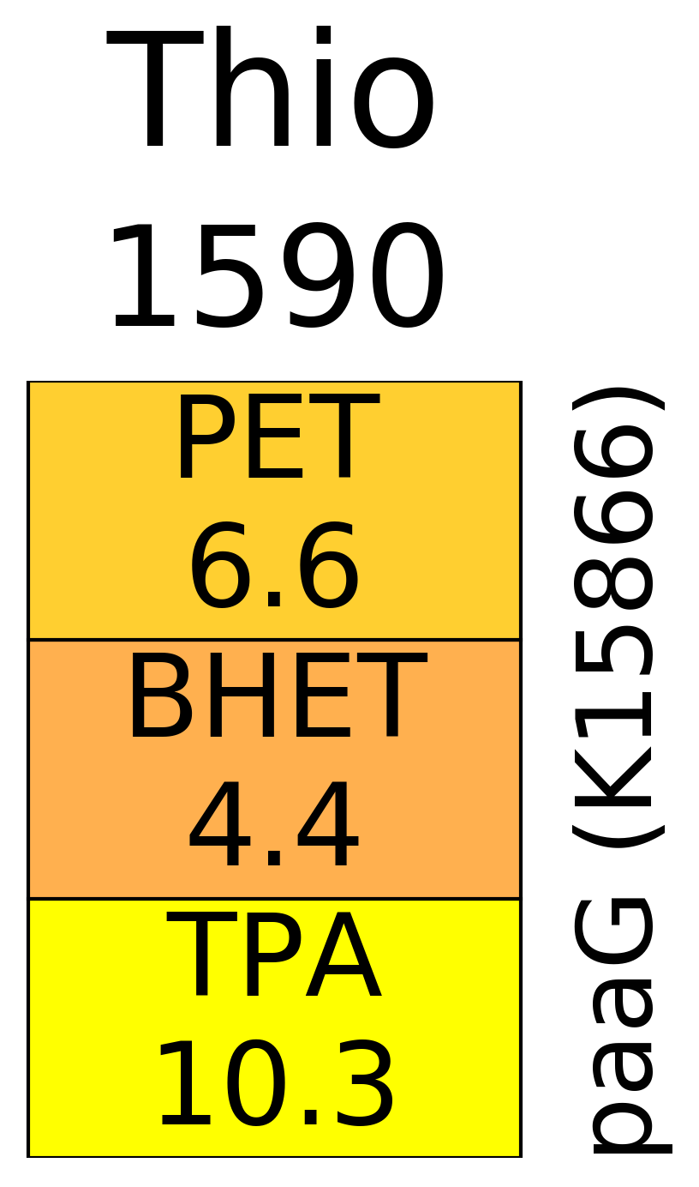
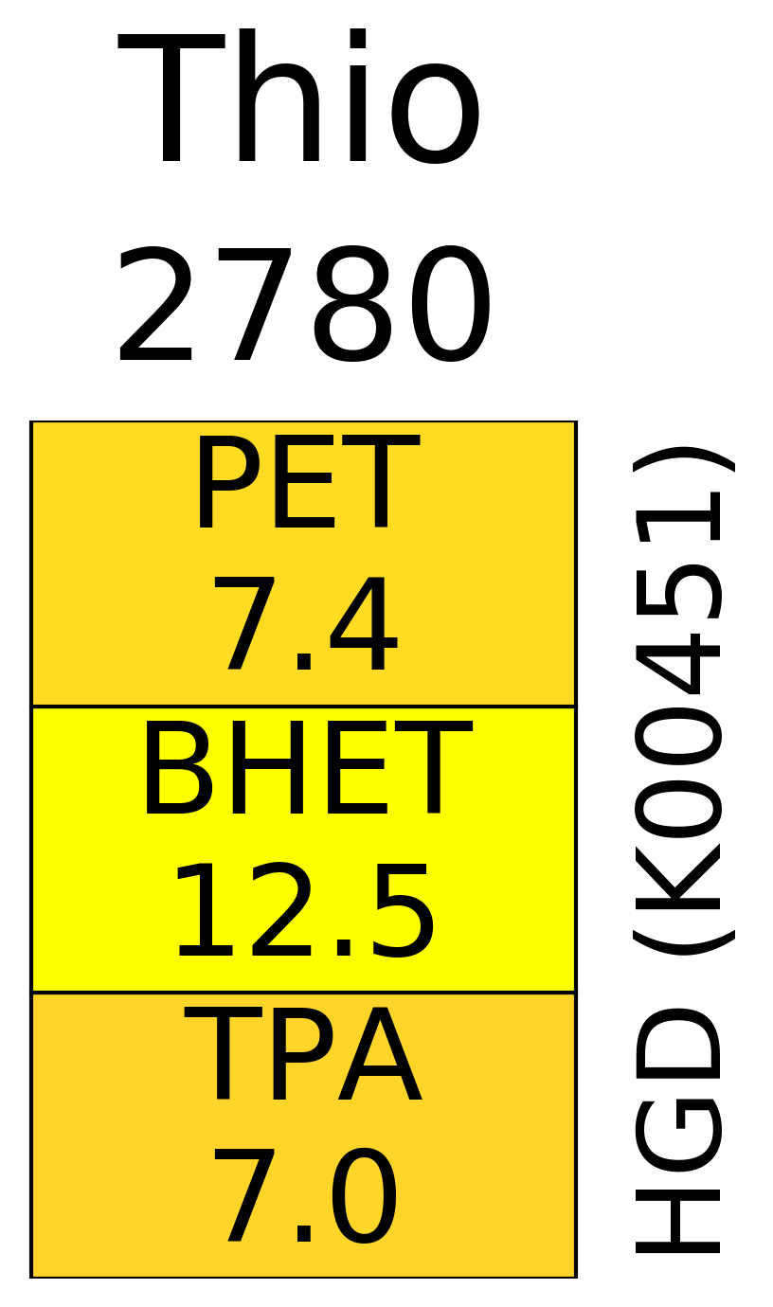
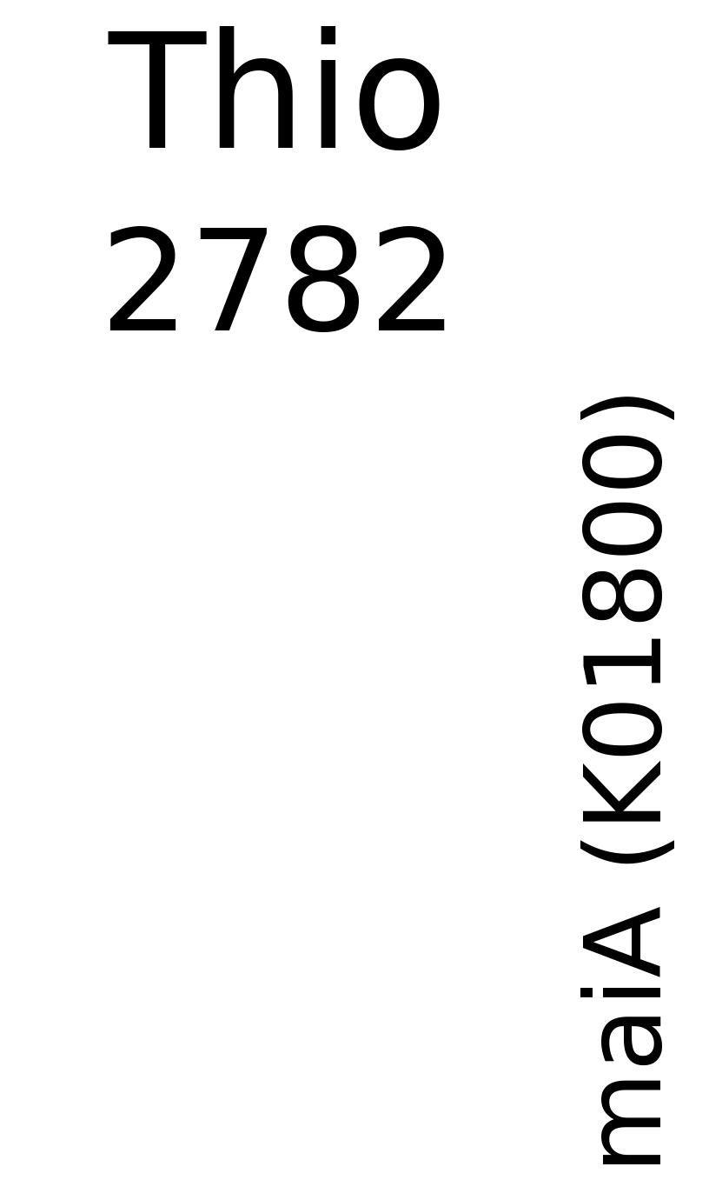
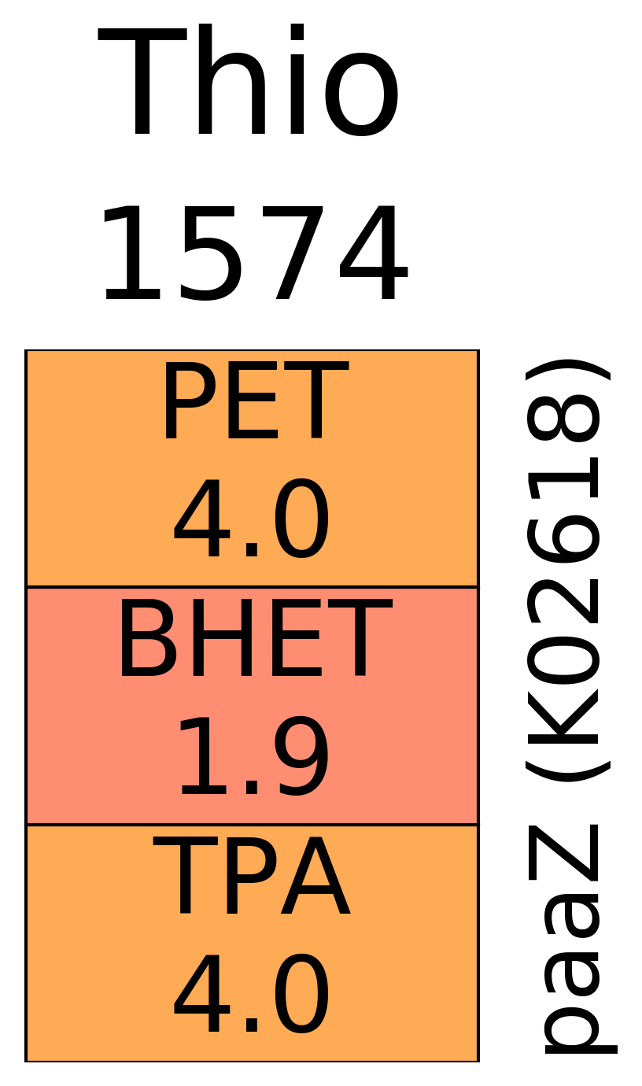
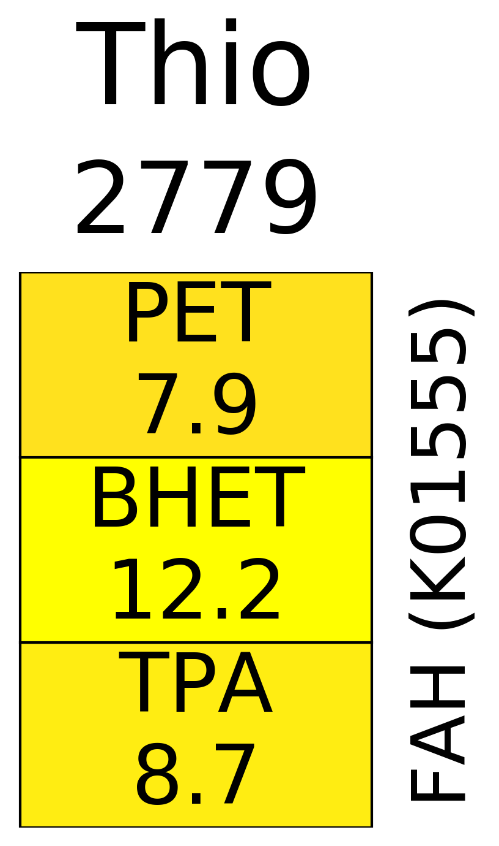
PET
Phenylacetate
Phenylacetate
Phenylacetate-CoA ligase
(paaK)
Phenylacetate 2-hydroxylase
(PHAA)
PHAA (K10437)
BHET
Phenylacetyl-CoA
2-hydroxyphenyl acetate
Ring-1,2-phenylacetyl-CoA epoxidase subunits A-E
(paaABCDE)
EC1.14.13.-
MHET
2-(1,2-epoxy-1,2-dihydro phenyl) acetyl-CoA
Homogentisate
2-(1,2-epoxy-1,2-dihydrophenyl)acetyl-CoA isomerase
(paaG)
Homogentisate 1,2-dioxygenase
(HGD)
2-oxepin-2(3H)-ylidene acetyl-CoA
4-maleylacetate
TPA
Maleylacetoacetate isomerase
(maiA)
Oxepin-CoA hydrolase
(paaZ)
Fumarylacetoacetate
3-oxo-5,6-dehydrosubaryl-CoA-semialdehyde
Fumarylacetoacetase
(FAH)
﻿1,6-dihydroxycyclohexa-2,4-diene-dicarboxylate
3-oxo-5,6-dehydrosuberyl-CoA semialdehyde dehydrogenase
(paaZ)
Fumarate
Acetoacetate
Decarboxylase?
3-oxo-5,6-didehydrosuberyl-CoA
Catechol
Protocatechuate
3-oxo-5,6-didehydrosuberyl-CoA thiolase
(paaJ)
paaJ (K02615)
Acetyl-CoA
(+)-muconolactone
𝛃 -carboxy muconate
𝛃 -ketoadipate pathway

Slide 2
A
PET
B
PETase
(K21404)
BHET
MHET
MHETase
(K21405)
TPA
?
bph, andAC
(K15750, K16319)
tphA2A3A1
(K18074,5,7)
﻿1,6-dihydroxycyclohexa-2,4-diene-dicarboxylate
?
tphB
(K18076)
Catechol
Protocatechuate
catAB
(K03381, K01856)
pcaGH
(K00448-9)
(+)-muconolactone
𝛃 -carboxy muconate
𝛃 -ketoadipate pathway
Aerobic
Phenylacetate
Anaerobic
PHAA (K10437)
paaK (K01912)
2-hydroxyphenyl acetate
Phenylacetyl-CoA
EC1.14.13.-
paaABCDE
(K02609-13)
Homogentisate
2-(1,2-epoxy-1,2-dihydro phenyl) acetyl-CoA
HGD
(K00451)
paaG
(K15866)
4-maleylacetate
2-oxepin-2(3H)-ylidene acetyl-CoA
maiA
(K01800)
Fumarylacetoacetate
paaZ
(K02618)
FAH
(K01555)
3-oxo-5,6-dehydrosuberyl-CoA semialdehyde
Fumarate
Acetoacetate
paaZ
(K02618)
3-oxo-5,6-didehydrosuberyl-CoA
paaJ
(K02615)
2,3-Didehydroadipyl-CoA
Acetyl-CoA

